Slide 1



Slide 2

C# 5.0 -What’s new?
С# 2 = Generics, Lambda
С# 3 = var, LINQ
C# 4 = dynamic, TPL
C# 5 = Async

Slide 3
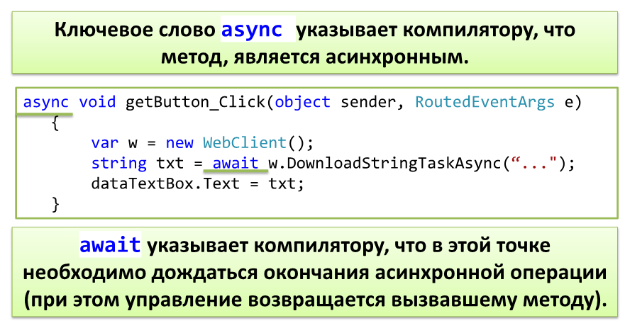

Slide 4
